Slide 1

ROBUST SECURITY CAMERA
SUPERVISOR
SIR SIKANDER KHAN
SAHAR BATOOL – 41598
HASNAIN RAZA – 41018
HUSSNA ALI – 44072
AFTAB HUSSAIN– 41699

Slide 2
OUTLINE
Introduction
Problem Statement
Aims and Objectives
Literature Review
Methodology
Main Features of the Project
Logical Diagrams
Results
ML Model
Web interface
Workload of the Project
Gantt Chart

Slide 3
INTRODUCTION
PROBLEM STATEMENT
1. Security
not taking advantages of Technology​
2. Spreading of Covid-19:​
SOPs are not followed

Slide 4
Cont’d
AIMS AND OBJECTIVES
1. Weapon Detection (CCTV)​
2. SOPS’ Application (CCTV)​
Counting People ​
Face Mask Detection​
3. Web Application ​
4. Mobile Application

Slide 5
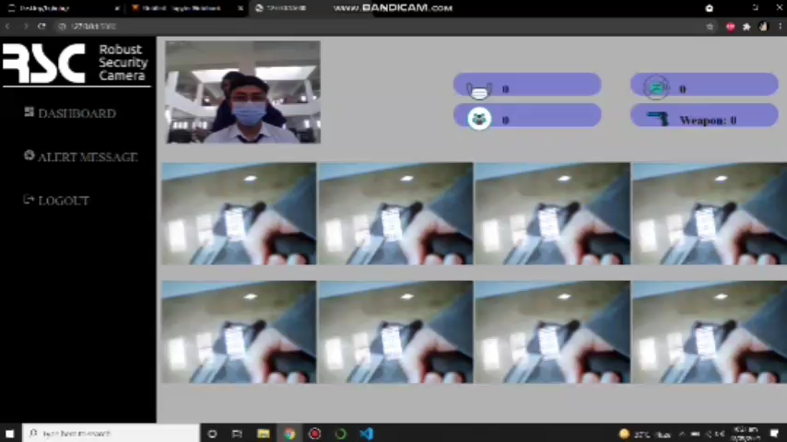
VIDEO(PROJECT OVERVIEW)

Slide 6
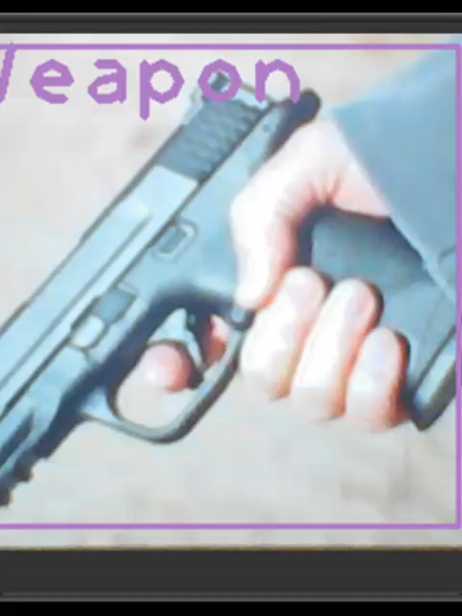
VIDEO(RESULT)

Slide 7
Literature Review
WEAPON DETECTION
Olmos et al proposed an automatic system for detecting handguns from CCTV videos. The researchers attempted to reduce the number of false detections by using a Deep Convolutional Neural Network (CNN) classifier. The objective of this research is to implement an automated and real-time firearm detection algorithm that assists a human operator by raising an alarm whenever a potentially threatening object (gun) is detected. To get the desired outcome the algorithm must be fully automatic, operate in real-time, accurate, and run on a standard personal computer.
MASK DETECTION
The system is integration of both machine learning and deep learning techniques with Tensor Flow, Open CV and Keras to identify the person with or without Mask on video/image stream. For training the system, first step is to train the Mobile NetV2 (Deep Learning Model) and then apply detector of face mask over video/images live stream.

Slide 8
Cont’d
COUNTING PEOPLE
Counting people is important not only for businesses but security purposes too. S. Saxena & D. Songara introduced an automatic people counting system which can count multiple people, by using only one camera. Their algorithm uses Viola Jones method of facial recognition to detect people; using a single overhead mounted camera, it counts the number of people going into an observed area. Counting is performed by analyzing the image to detect faces and the system achieves correct people counting rate of 85%.

Slide 9
METHODOLOGY
MAIN FEATURES OF THE PROJECT
Weapon Detection
Face Mask Detection
People Counting
Web Application
Mobile Application

Slide 10
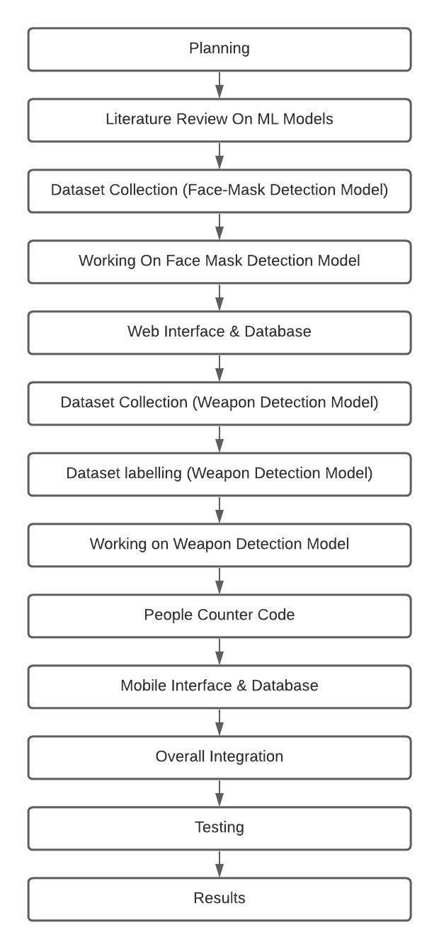
Cont’d

Slide 11
RESULTS

Slide 12
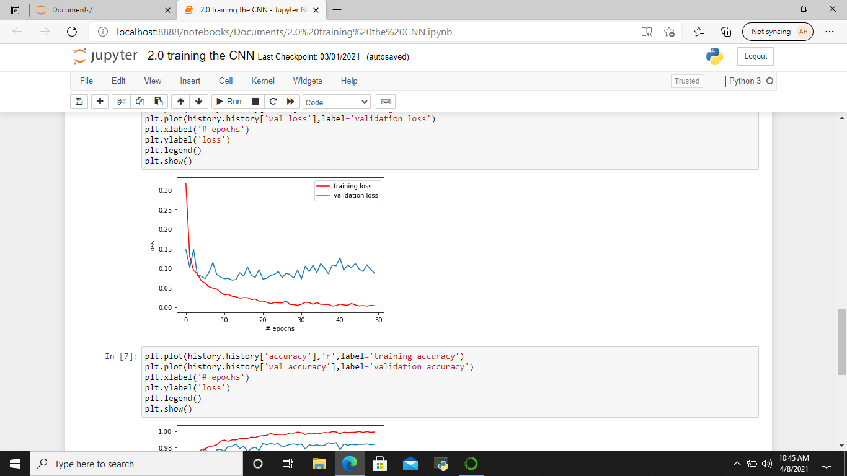
FACE MASK DETECTION MODEL
MODEL LOSS

Slide 13
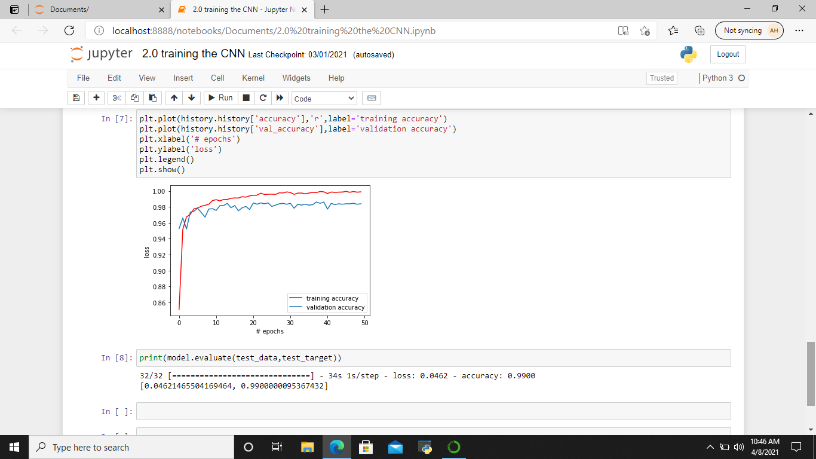
Cont’d
TRAINING AND VALIDATION ACCURACY GRAPH

Slide 14

Cont’d
MODEL ACCURACY

Slide 15
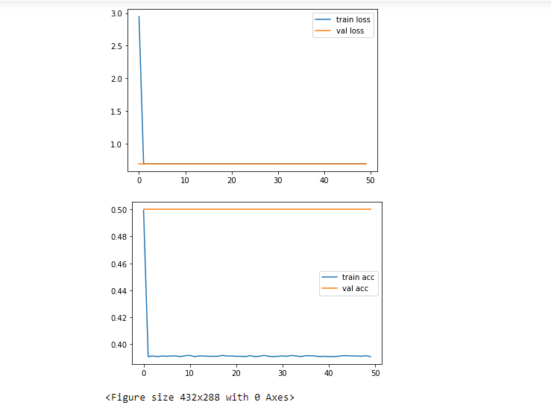
WEAPON DETECTION MODEL

Slide 16
WEAPON DETECTION MODEL

Slide 17

Cont’d

Slide 18
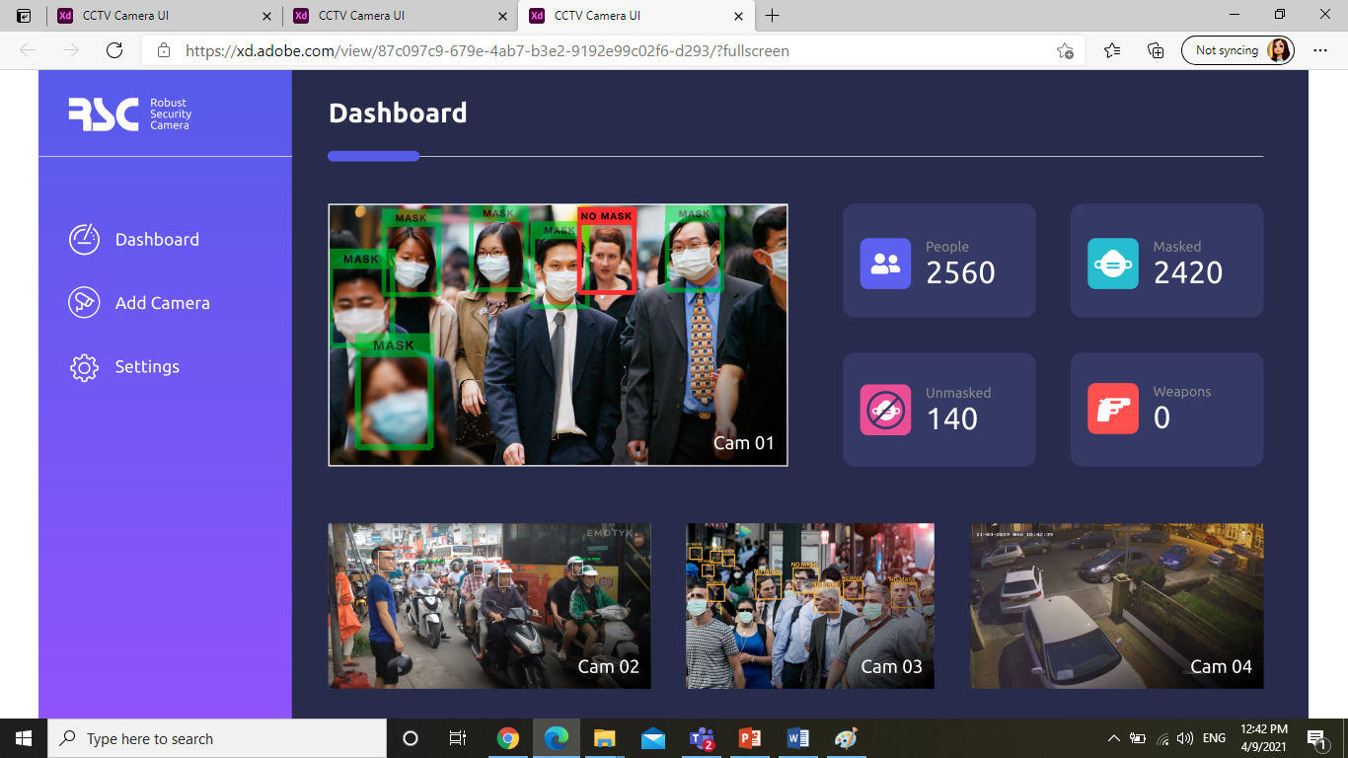
WEB INTERFACE (PROTOTYPE)

Slide 19

WEB INTERFACE (LOG IN)

Slide 20
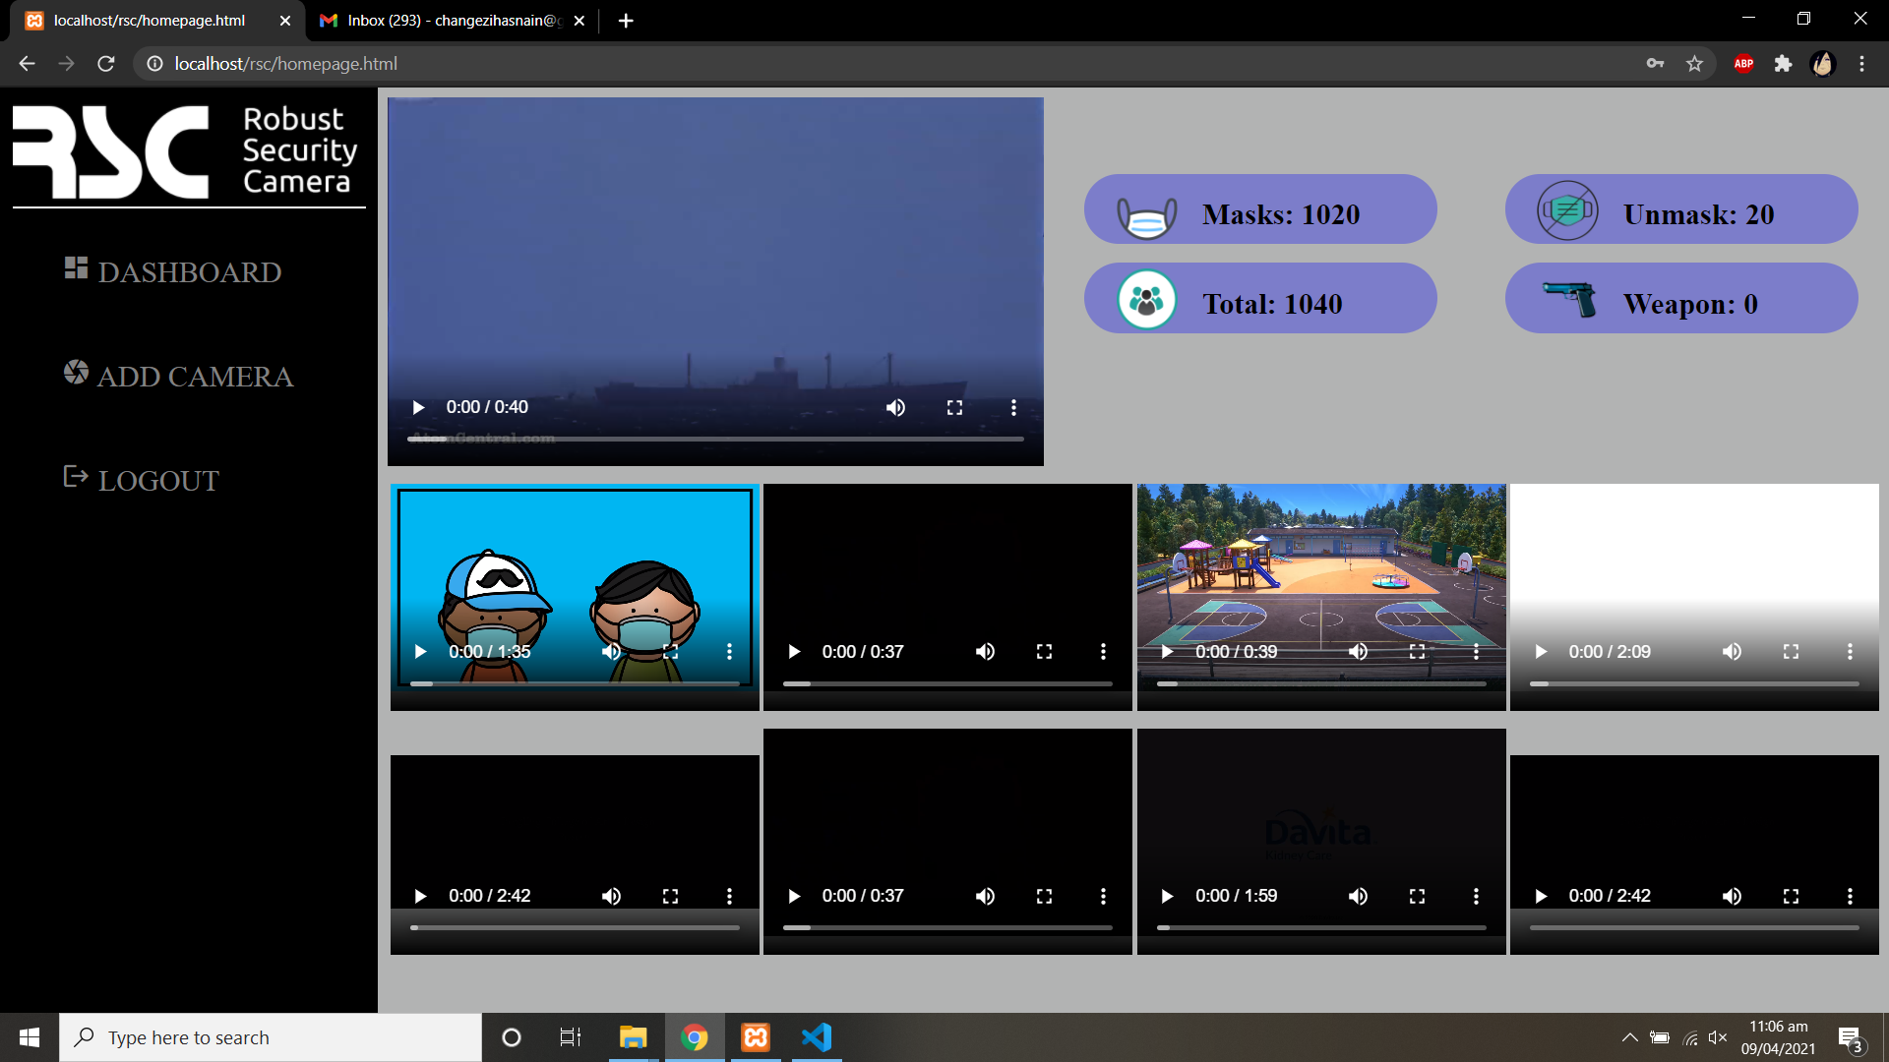
WEB INTERFACE (HOME)

Slide 21

MOBILE INTERFACE (REGISTRATION)

Slide 22

MOBILE INTERFACE (LOGIN)

Slide 23

MOBILE INTERFACE (HOME)

Slide 24
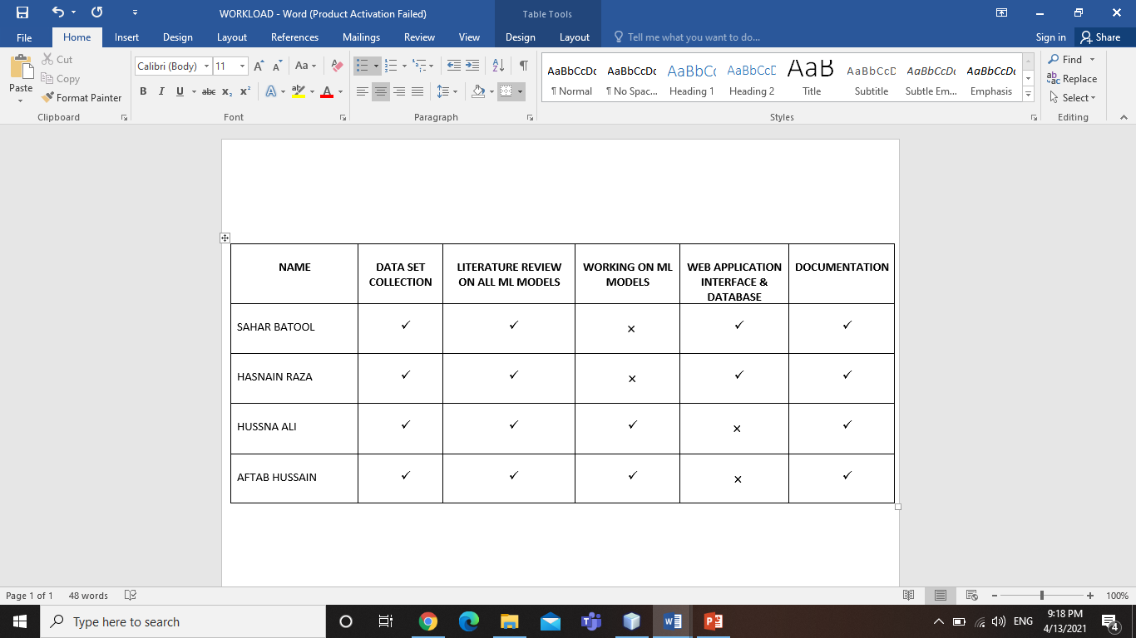
WORKLOAD OF THE PROJECT (PHASE 1)

Slide 25
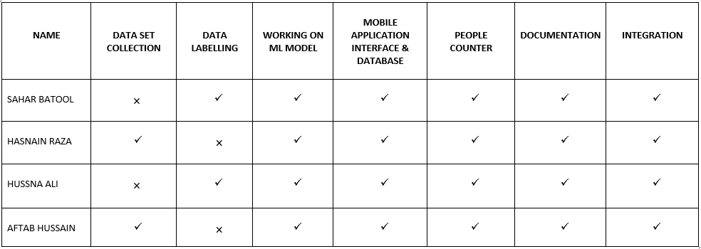
WORKLOAD OF THE PROJECT (PHASE 2)

Slide 26
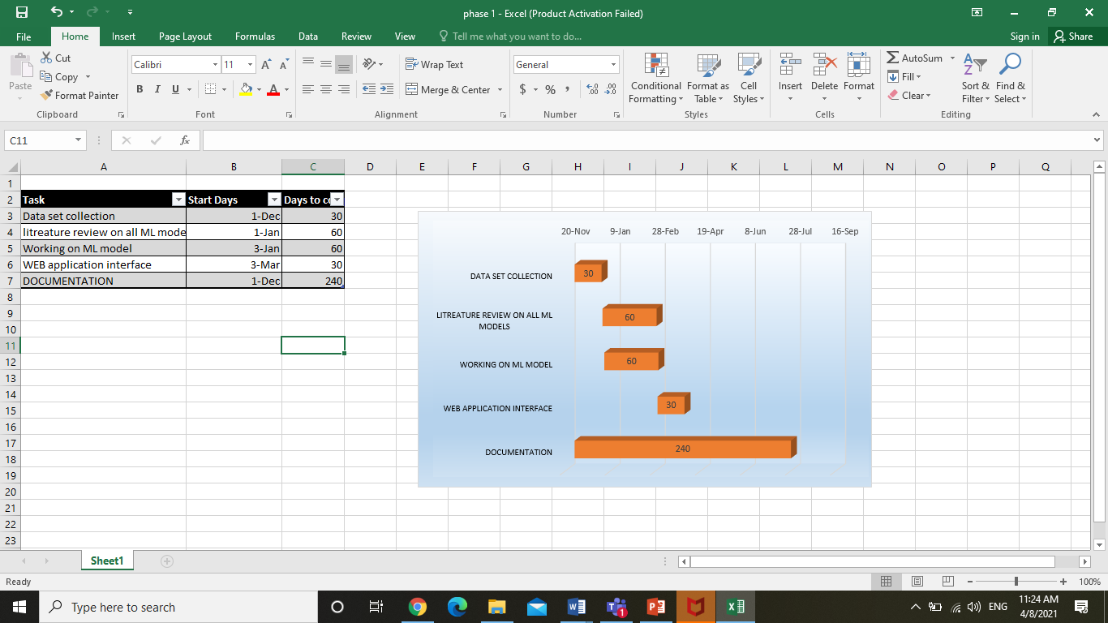
GANTT CHART
PHASE-1

Slide 27
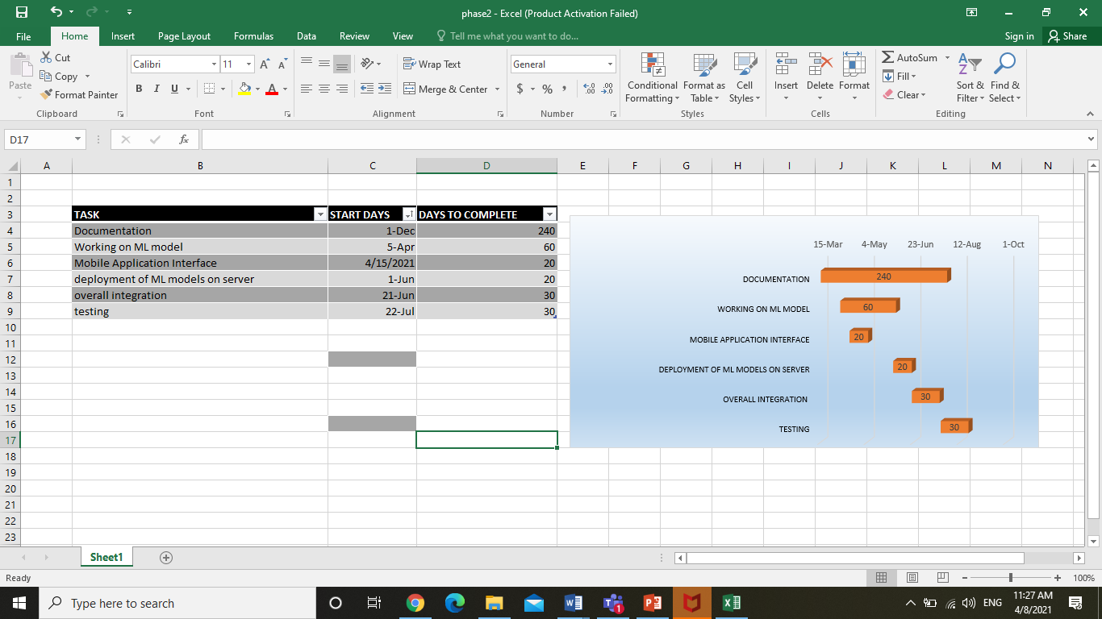
GANTT CHART
PHASE-2

Slide 28
REFERENCES
Olmos, R., Tabik, S., & Herrera, F. (2018). Automatic handgun detection alarm in videos using deep learning. Neurocomputing, 275, 66–72. https://doi.org/10.1016/j.neucom.2017.05.012
Bhadani, A. K., & Sinha, A. (2020). A Facemask Detector using Machine Learning and Image Processing Techniques. Engineering Science and Technology , an International Journal, November, 0–8. https://www.researchgate.net/publication/345972030_A_FACEMASK_DETECTOR_USING_MACHINE_LEARNING_AND_IMAGE_PROCESSING_TECHNIQUE
Saxena, Surbhi & Songara, Dalpat. (2017). Design of people counting system using MATLAB. 1-3. 10.1109/IC3.2017.8284344.

Slide 29
LOGICAL DIAGRAMS

Slide 30
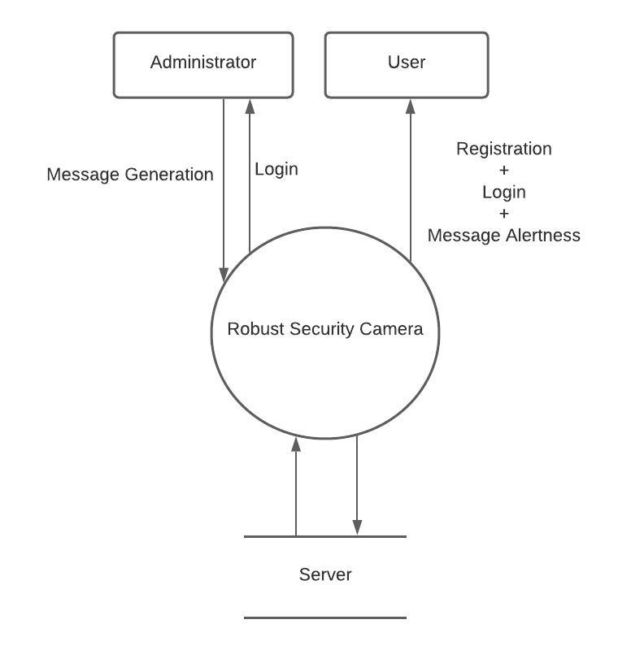
FLOW DIAGRAM

Slide 31
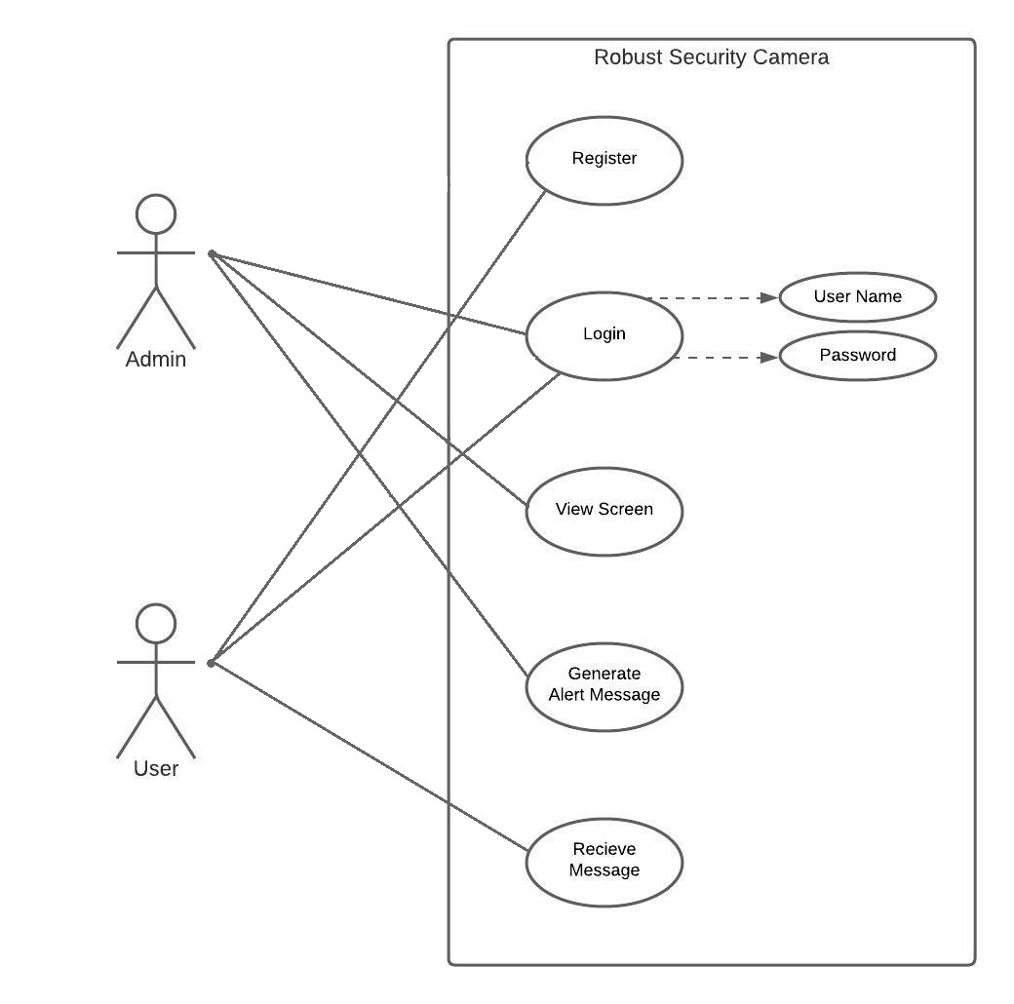
USE CASE DIAGRAM

Slide 32
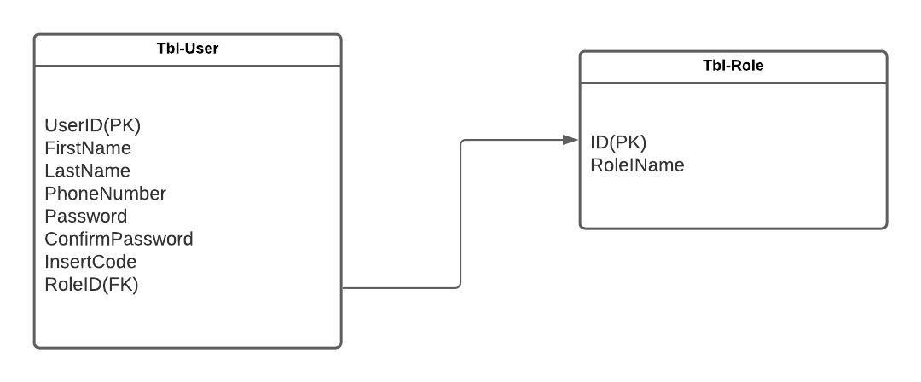
ER DIAGRAM

Slide 33
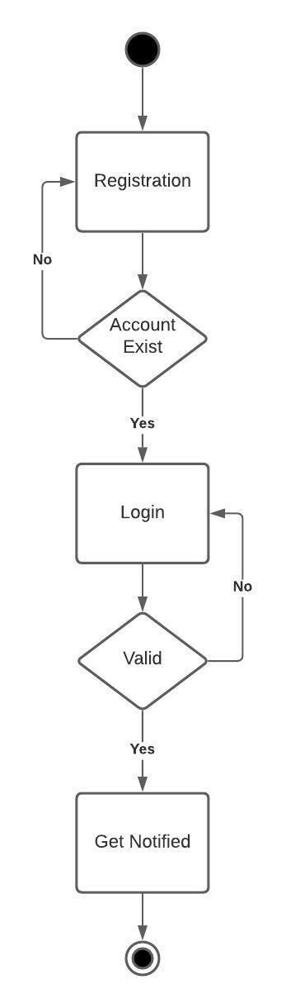
ACTIVITY DIAGRAM (USER)

Slide 34
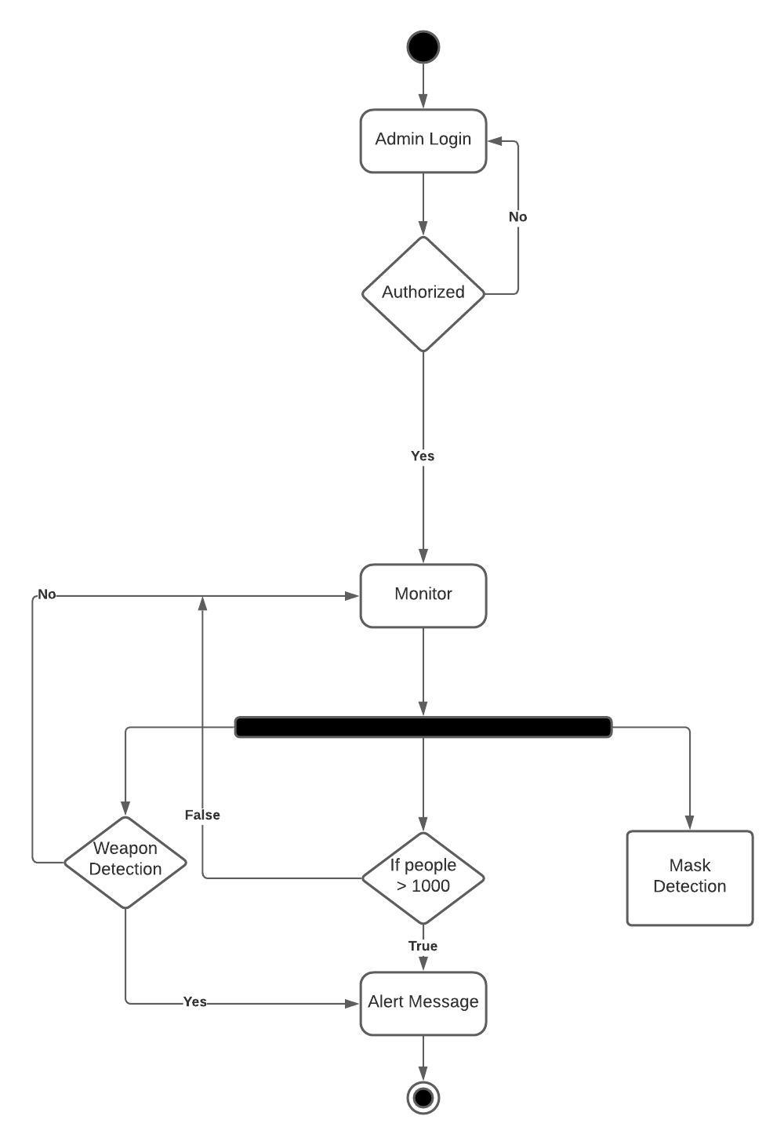
ACTIVITY DIAGRAM (ADMIN)

Slide 35
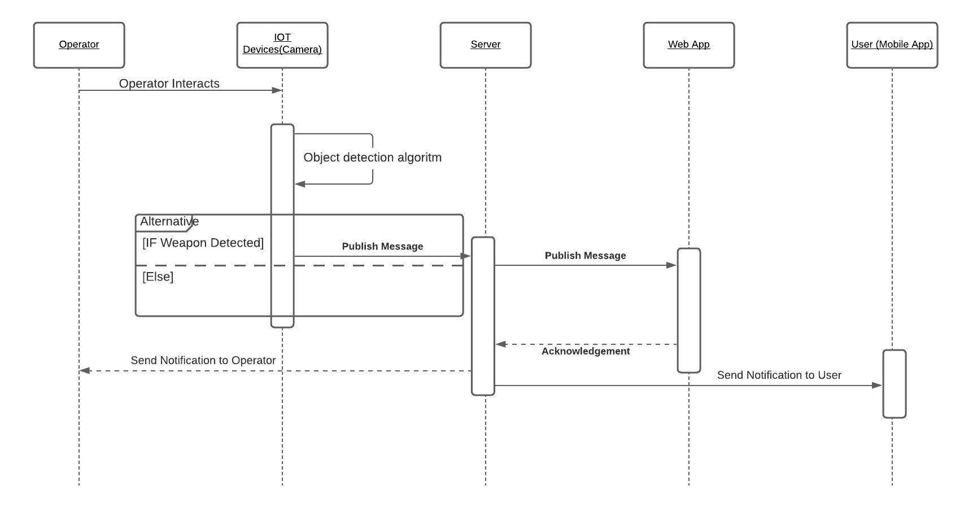
SEQUENCE DIAGRAM

Slide 36
THANK YOU

